Slide 1


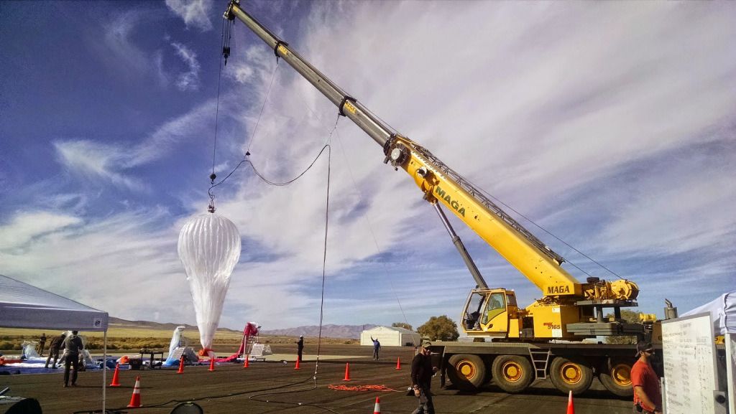
Internet Balloons
The Beauty and Joy of Computing Lecture #21
Future of Computing
From TechCrunch: Today, Sri Lanka announced that it’s the first country to ever get universal Internet access from Google’s Project Loon. Thanks to a partnership with Google, the country promises “affordable high-speed Internet” for all of its residents.
http://techcrunch.com/2015/07/29/not-so-loony-now-is-it/

Slide 2
Admin Notes
Schedule (see website)
Explore Post Due Tomorrow
Comments Monday!
Must have 3, but comment more ☺
Final Projects –
Be Creative and ambitious

Slide 3
Lecture Overview
Where will today’s computers go?
Quantum Computing
Biological Computing & Interfaces

Slide 4
Where will today’s computers go?

Slide 5
Computer Technology … Growth!
Processor
Speed 2x / 2 years (since ’71)
100X performance last decade
When you graduate: 4 GHz, 32 Cores
Memory (DRAM)
Capacity: 2x / 2 years (since ’96)
64x size last decade.
When you graduate: 128 GibiBytes
Disk
Capacity: 2x / 1 year (since ’97)
250X size last decade.
When you graduate: 16 TeraBytes
Kilo (10³) & Kibi (2¹⁰)
⬇
Mega (10⁶) & Mebi (2²⁰)
⬇
Giga (10⁹) & Gibi (2³⁰)
⬇
Tera (10¹²) & Tebi (2⁴⁰)
⬇
Peta (10¹⁵) & Pebi (2⁵⁰)
⬇
Exa (10¹⁸) & Exbi (2⁶⁰)
⬇
Zetta (10²¹) & Zebi (2⁷⁰)
⬇
Yotta (10²⁴) & Yobi (2⁸⁰)
☑

Slide 6
Kilo, Mega, Giga, Tera, Peta, Exa, Zetta, Yotta
Kid meets giant Texas people exercising zen-like yoga. – Rolf O
Kind men give ten percent extra, zestfully, youthfully. – Hava E
Kissing Mentors Gives Testy Persistent Extremists Zealous Youthfulness. – Gary M
Kindness means giving, teaching, permeating excess zeal yourself. – Hava E
Killing messengers gives terrible people exactly zero, yo
Kindergarten means giving teachers perfect examples (of) zeal (&) youth
Kissing mediocre giraffes teaches people (to) expect zero (from) you
Kinky Mean Girls Teach Penis-Extending Zen Yoga
Kissing Mel Gibson, Teddy Pendergrass exclaimed: “Zesty, yo!” – Dan G
Kissing me gives ten percent extra zeal & youth! – Dan G (borrowing parts)

Slide 7
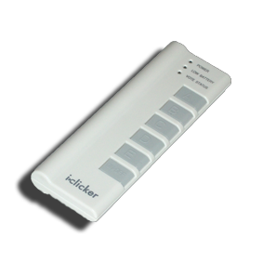
Peer Instruction
What was recently proposed to go after Yotta? (i.e., 10²⁷)
Lotta
Lotsa
Wholelotta
Hella
Zillion
Both Google’s and WolframAlpha’s calculator can understand and use “Hella” in their calculations!
www.makehellaofficial.blogspot.com

Slide 8
Quantum Computing

Slide 9
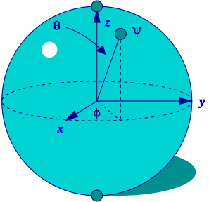
Quantum Computing (1/3)
en.wikipedia.org/wiki/Quantum_computer
Proposed computing device using quantum mechanics
This field in its infancy…
Normally: bits, which are either 0 or 1
Quantum: qubits, either 0, 1 or “quantum superposition” of these
This is the key idea
If you have 2 bits, they’re in exactly one of these:
00, 01, 10 or 11
If you have 2 qubits, they’re in ALL these states with varying probabilities
A Bloch sphere is the geometric representation of 1 qubit
en.wikipedia.org/wiki/Quantum_computer

Slide 10
Quantum Computing (2/3)
Imagine a problem with these four properties:
The only way to solve it is to guess answers repeatedly and check them,
There are n possible answers to check,
Every possible answer takes the same amount of time to check, and
There are no clues about which answers might be better: generating possibilities randomly is just as good as checking them in some special order.
…like trying to crack a password from an encrypted file
A normal computer
would take (in the worst case) n steps
A quantum computer
can solve the problem in steps proportional to √n
Why does this matter?

Slide 11
Quantum Computing (3/3)
Say the password is exactly 72 bits (0/1)
That’s 2⁷² possibilities
10 char password ~2⁶⁰
Let’s say our Mac lab attacked the problem
30 machines/lab * 8 cores/machine * 3 GHz (say 3 billion checks per second/core)
= 720,000,000,000 checks/sec/lab
= 720 Gchecks/sec/lab
Regular computers
2⁷² checks needed / 720 Gchecks/sec/lab
≈ 6.6 billion sec/lab
≈ 208 years/lab
72-qubit quantum computers in timeαto √2⁷² = 2³⁶
2³⁶ checks needed / 720 Gchecks/sec/lab
≈ 0.1 sec/lab

Slide 12

NSA seeks to build Quantum computer
www.washingtonpost.com/world/national-security/nsa-seeks-to-build-quantum-computer-that-could-crack-most-types-of-encryption/2014/01/02/8fff297e-7195-11e3-8def-a33011492df2_story.html
Washington Post, 2014-01-03: “The U.S. National Security Agency (NSA) is trying to develop a quantum computer that could be used to crack almost any type of encryption currently in use, according to documents released by former NSA contractor Edward Snowden.”
“Once completed, the computer could be used to crack almost every type of encryption used to protect state secrets and other sensitive information, such as 1,024-bit RSA encryption keys, which would take hundreds of standard computers working together about 2,000 years to crack.”

Slide 13

Quantum Computing Explained by Physicists
www.youtube.com/watch?v=T2DXrs0OpHUs

Slide 14
Biological Computing & Interfaces

Slide 15
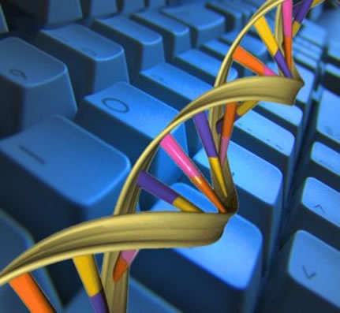
DNA Computing
en.wikipedia.org/wiki/DNA_computing
Proposed computing device using DNA to do the work
Take advantage of the different molecules of DNA to try many possibilities at once
Ala parallel computing
Also in its infancy
Papers in “Nature”
In 2004, researchers claimed they built DNA Computer!
In 2013, researchers stored (and retrieved!) data on DNA (All Shakespeare’s sonnets and audio clip of “I have a dream”)
☑

Slide 16
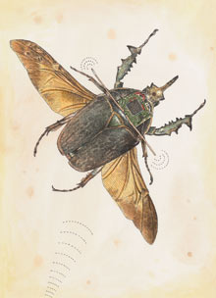
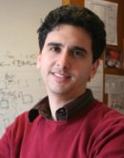
Biological Machines
www.technologyreview.com/article/412185/tr10-biological-machines/
Michel Maharbiz and his team at Cal have wired insects (here a giant flower beetle) and can control flight
Implated as Pupa
Vision
Imagine devices that can collect, manipulate, store and act on info from environment

Slide 17
Peer Instruction
What is the most exciting future for computing?
Incremental improvements in computing architectures
Quantum computing
DNA computing
Biological Machines
Something completely different

Slide 18
Summary
What a wonderful time we live in; we’re far from done
What about privacy?
Find out the problem you want to solve
Computing will probably help get you there!
We probably can’t even imagine future software + hardware breakthroughs

